Slide 1


Slide 2
AGENDA
OBJECTIVE
BACKGROUND
KEY FINDINGS
RECOMMENDATION
APPRENDIX
DATA METHODOLOGY
DATA MODEL ASSUMPTION
DATA SOURCES

Slide 3

OBJECTIVE
Improve our shared understanding about customer preferences.
Provide recommendation to our operational and marketing team .
Improve understanding of customer behaviour.

Slide 4
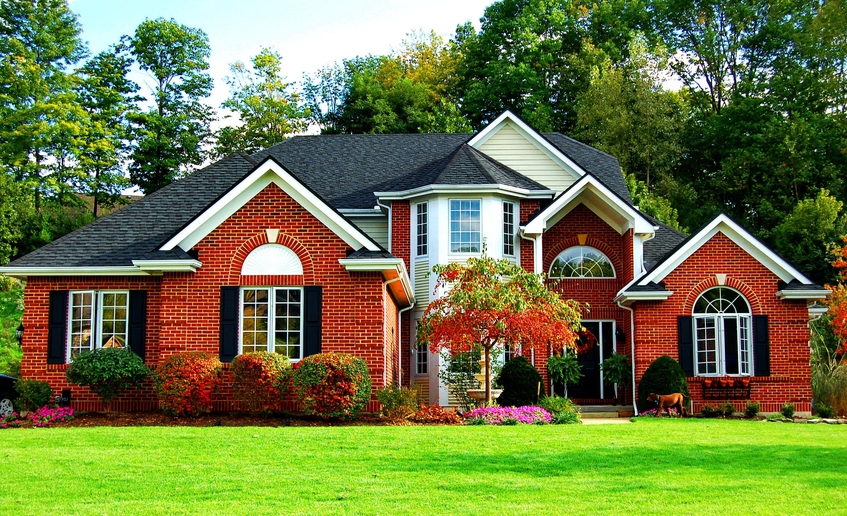
BACKGROUND
Airbnb has seen a major decline in revenue in past few months.
Globally the restriction has been imposed due to pandemic.
Now that the restrictions have started lifting ,people have started to travel, Airbnb wants to make sure that it is fully prepared for this change.

Slide 5
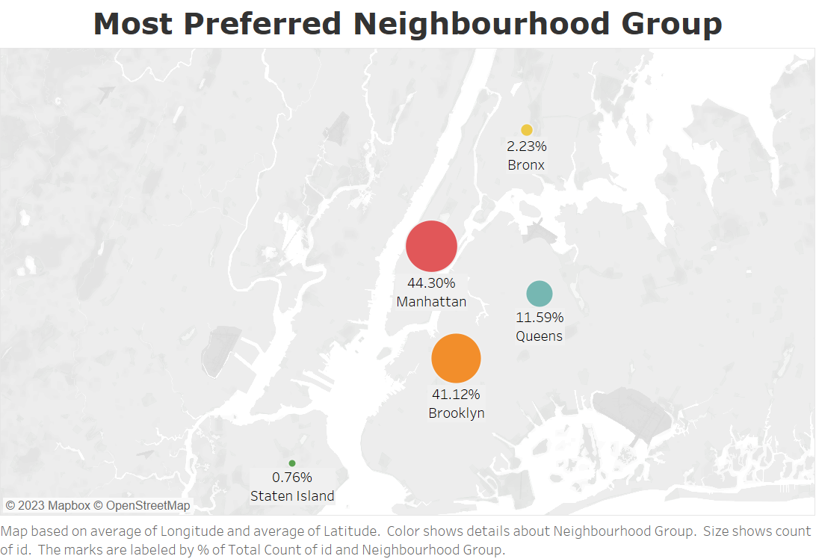
Most Preferred Neighbourhood Group
The Most Neighbourhood Group in New York is Manhattan followed by Brooklyn.
▪ The Booking of the Manhattan is high as compared to other Tho people preferred it due to it famous attraction and scenic view.
▪ About 44.3% of booking from total listing is only in Manhattan , 41.12% in Brooklyn & 11.59% in Queens
▪ Staten Island and Bronx are the least preferences of customer due to its few tourist attraction points only 0.76% of total listing is of Staten Island and Bronx has 2.23% of booking.

Slide 6
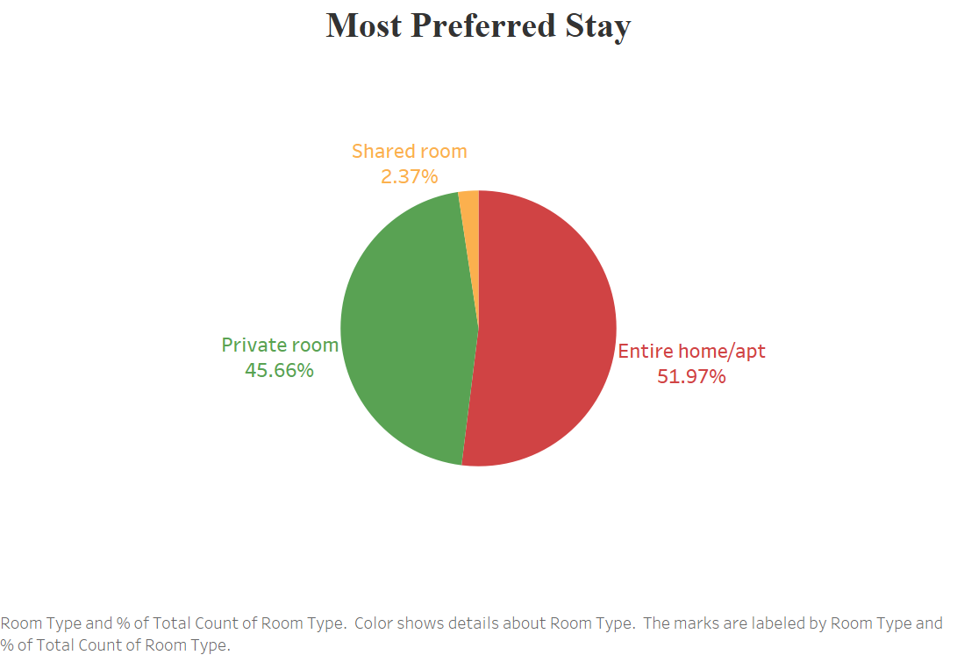
Most Preferred Stay
51.97% of people prefer to stay in Entire home/Apartment and 45.66% prefer to in Private Room.
▪ Only 2.37% of people like to stay in Shared rooms. This is due to most people like to stay in their private space and don’t want any kind of disturbance during there stay.

Slide 7
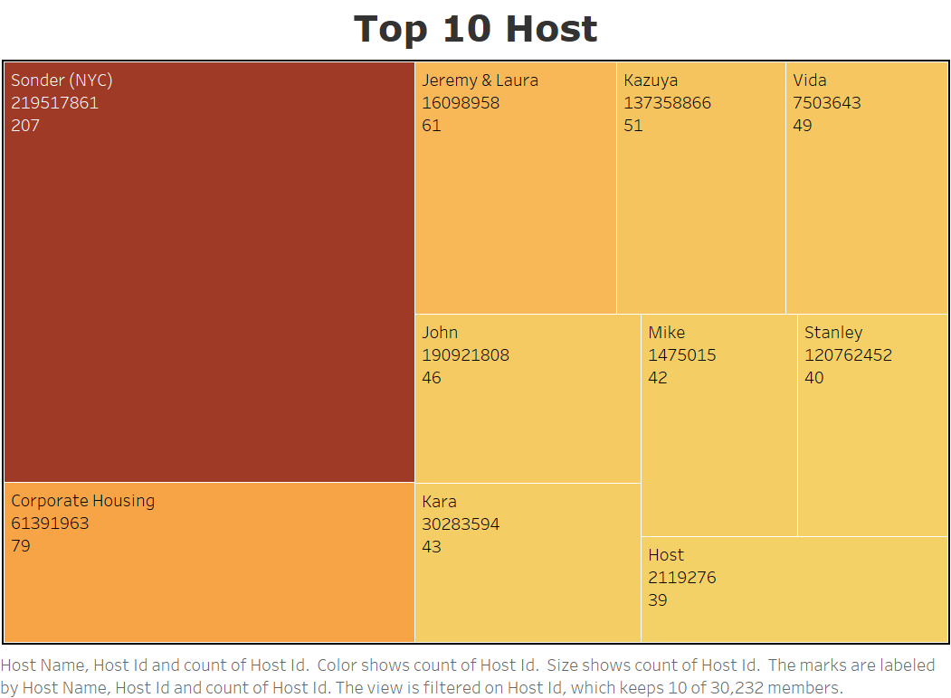
Top 10 Host
The property of host Sonder(NYC) has booked maximum times about 207 times by the people.
The host Corporate Housing is at second place with booked count of 79

Slide 8
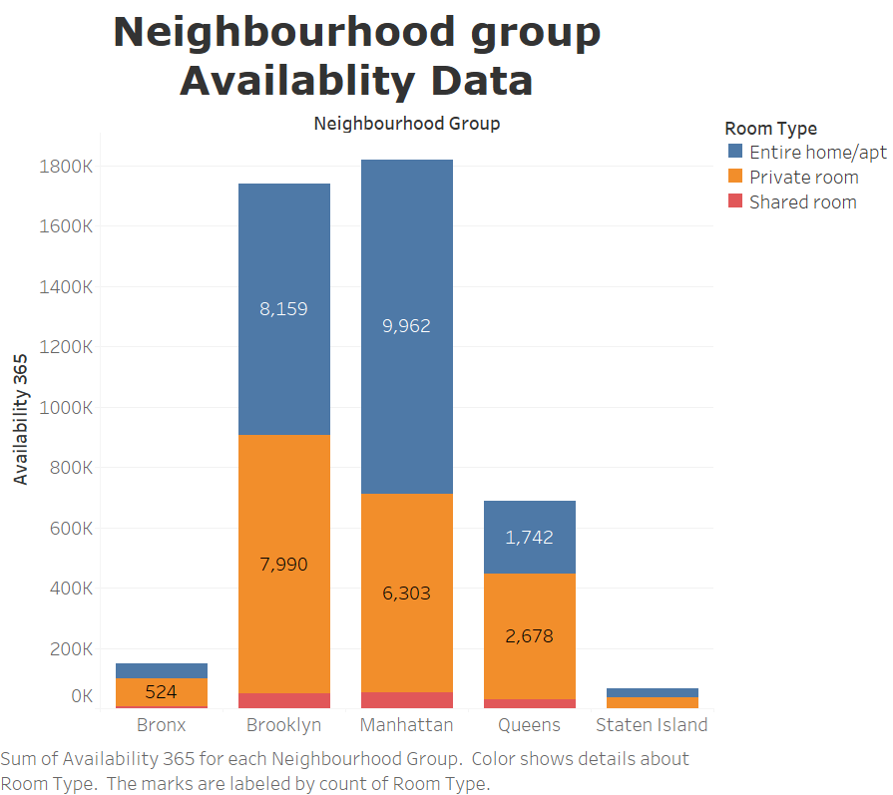
Neighbourhood Group Availability Data
Manhattan city has maximum available rooms followed by Brooklyn City
The Bronx and Staten Island has very less availability so we have to increase the availability in these cities.

Slide 9
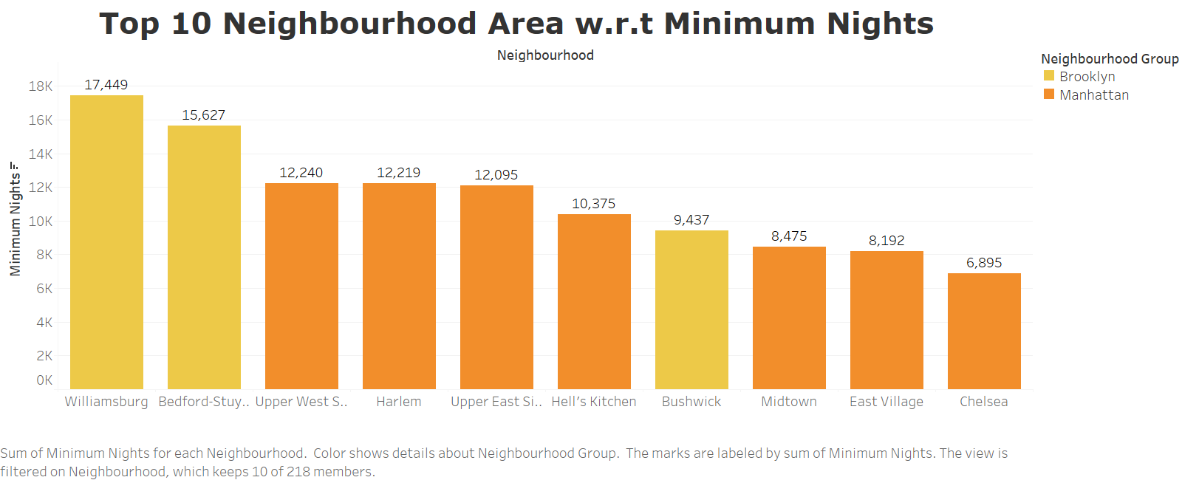
Top 10 Neighbourhood Area w.r.t Minimum Nights
The Williamsburg & Bedford area are most preferred location to stay by people in Brooklyn City.
The Upper-West Side, Harlem & East-West Side areas preferred by people to stay in Manhattan City.

Slide 10
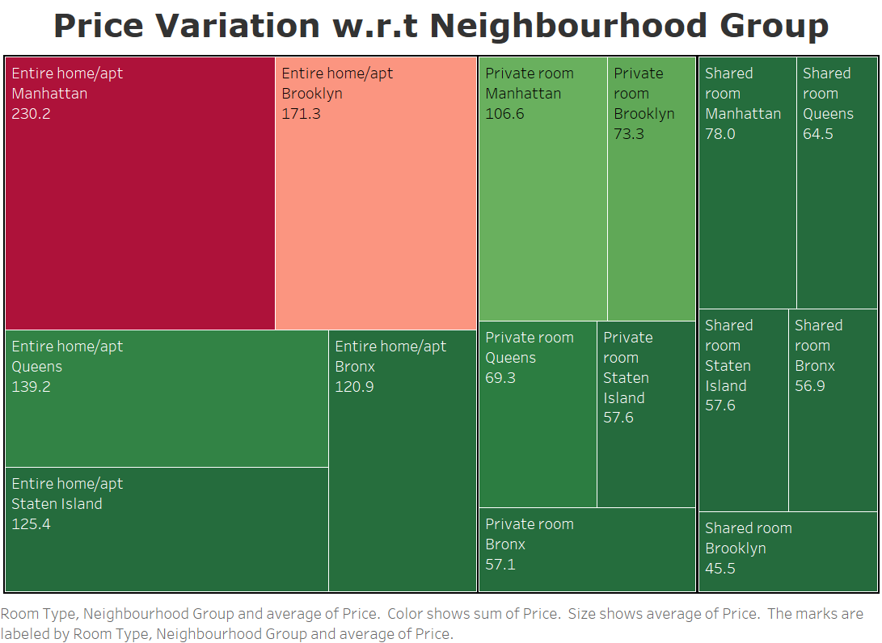
Price Variation w.r.t Neighbourhood Group
Entire home/apt in Manhattan and Brooklyn is most expensive of the available listing.
The Avg price of Entire home/apt in Queens and Bronx of $130.
Brooklyn has the cheapest Shared room with Avg price of $45.5 in available listing.

Slide 11
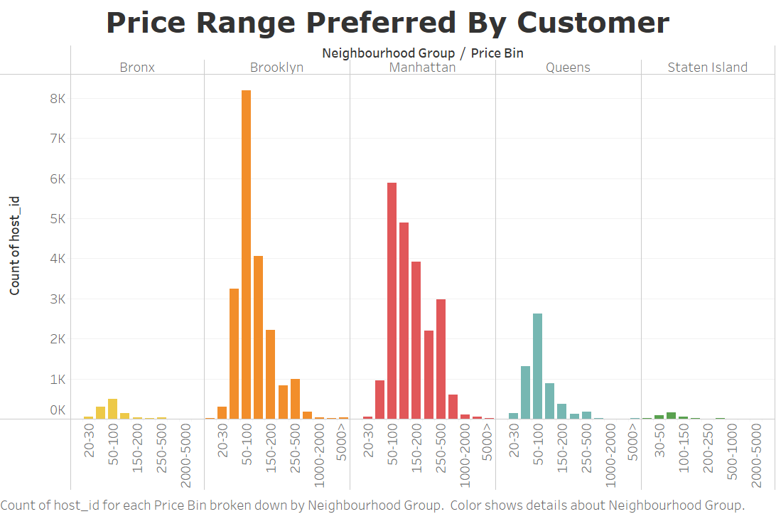
Price Range Preferred By Customer Based on Neighborhood group
The Most Preferred Price Range of Customer is from $50-$200 based on Neighborhood Group and Booking volume.
The price range of $50-$100 is preferred most in Brooklyn.
The price range of $50-$200 is preferred most in Manhattan this is because the as Manhattan is major attraction people are likely to spend more.

Slide 12
Recommendation
Increased the no of Entire Home/apt in Bronx , Queens & Staten Island as they are preferred most by customers.
The Cost of Entire Home/apt in Manhattan should be reduced and cost of shared rooms to be increased to reduce the price gap between shared rooms and private rooms so that shared room customer will attract toward private rooms.
Provide discounts for shared rooms and run promotion campaign to increased there booking percentage.
Acquire host in Bronx and Staten Island city having both Entire home/apt and Private rooms as both are preferred most.
Acquire the listing in price range of $50-$200 to increase the booking volume.

Slide 13
Appendix Data Methodology
Conducted Detailed Analysis on Airbnb New York dataset the process included:
Data Cleaning and handling outliers.
Creating pivot table to compare various segments such as room type etc.
Performing EDA to identifying top neigh hood area and groups , Top Host .
Deriving insights using visualization tool Tableau Tool.

Slide 14
Appendix Data Assumption
The Null Values assume to be of No impact on data in analysis
No of review are assume for best measure for the customer preferences

Slide 15
Appendix Data Sources
Here is the snapshot of the data set.
Host listing information like Host ID, Neighbourhood area and city information, Pricing and room type.
Airbnb listing geolocation like longitude and latitude
Customer preferences information like no of review and last review

Slide 16
Thankyou

